Slide 1
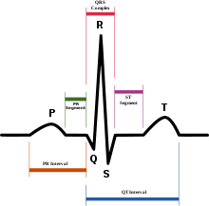
General EKG
QRS
1. Atrium repolarize
2. Ventricles depolarize down the Purkinje fibers
3. Ventricles contract
P wave:
Conduction from
SA to AV
1. Atrial depolarize
2. Atrial contraction
Tachycardia = P wave appears early
Bradycardia = P waves appears late
ST
1. Ventricle is depolarized
(Ventricle holding contraction)
T wave
1. Ventricular Repolarized
(May fire again
afterdepolarization)
PR segment:
AV delay
PR Interval
Conduction from SA to AV +
AV delay
QT interval represents the duration of activation and recovery of the ventricular myocardium. QT interval represents the duration of activation and recovery of the ventricular myocardium.
Notes:
http://www.youtube.com/watch?v=J_vRlHeW6TI
http://www.youtube.com/watch?v=plomIvk7Kdk
30:00 Ischemia = weak membrane potential which might have weaker, cations can leak in so cardiac cell isn’t able to rest → triggered automaticicity arrhythmias
33:00 Re-entry
35:00 EKG
Sinus tachycardia (SA node) P waves happen earlier
52:50 EKG arrhythmia

Slide 2
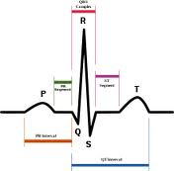
ACS
Acute Coronary Syndrome (ACS): any group of symptoms attributed to obstruction of the coronary arteries
ACS Classification
1. Unstable Angina (UA)
2. Non ST-segmented Elevation Myocardial Infarction (NSTEMI)
3. ST-elevation Myocardial Infarction (STEMI) 100% of coronary artery is blocked
Modifiable ACS Risk Factors | Non-modifiable ACS Risk Factors
Physical Inactivity Obesity (especially abdominal) Smoking Hyperlipidemia HTN (can rupture plaque) | Age Male gender Family history of premature CHD History of CAD, including MI DM
Notes:
Syndrome: syndrome is the association of several clinically recognizable features, signs (observed by someone other than the patient), symptoms (reported by the patient), phenomena or characteristics that often occur together, so that the presence of one or more features alerts the healthcare provider to the possible presence of the others. In recent decades, the term has been used outside medicine to refer to a combination of phenomena seen in association.

Slide 3
Diagnosis of ACS
Cardiac Catheterization (gold standard)
EKG
Positive Cardiac Biomarkers (measured 3 times)
CK CreaTINE Kinase
CK-MB CreaTINE kinase MB isoenzyme
Troponin I/T

Slide 4
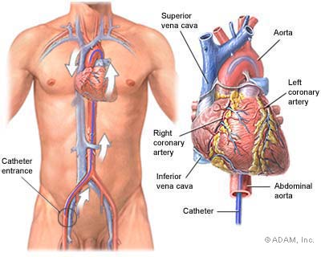
Diagnosis of ACS
Cardiac Catheterization (gold standard)
2. EKG
3. Positive Cardiac Biomarkers (measured 3 times)
CK CreaTINE Kinase
CK-MB CreaTINE kinase MB isoenzyme
Troponin I/T

Slide 5
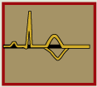
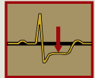
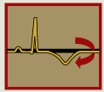

Diagnosis of ACS
Cardiac Catheterization (gold standard)
EKG
Positive Cardiac Biomarkers (measured 3 times)
CK CreaTINE Kinase
CK-MB CreaTINE kinase MB isoenzyme
Troponin I/T
Normal
Non-STEMI or Unstable Angina
Left figure is ST segment depression
Right figure is T wave inversion
Meaning: patient has NSTEMI or unstable angina
STEMI
Meaning: Patient’s arteries are 100% blocked
worst thing you can get
Notes:
STEMI has an increase in ST wave b/c during injury, the tissue releases a current towards the EKG reader.

Slide 6
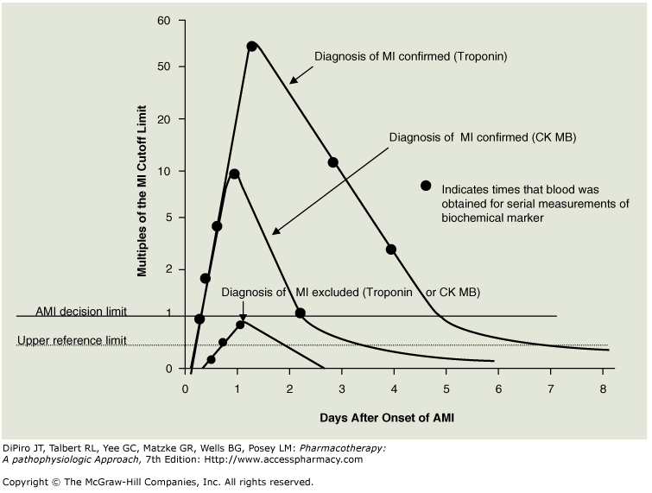
Diagnosis of ACS
Cardiac Catheterization (gold standard)
EKG
Positive Cardiac Biomarkers (measured 3 times)
CK CreaTINE Kinase
CK-MB CreaTINE kinase MB isoenzyme
Troponin I/T
Biomarkers present in
- STEMI patients
- NSTEMI patients
- NOT patients with unstable angina (b/c no muscle breakdown)
CKMB remains elevated for 2 days
Troponin remains elevated for 10 days
CKMB & Troponin elevates within 6 hours

Slide 7
ACS can cause:
Cardiogenic Shock: condition in which your heart suddenly can't pump enough blood to meet your body's needs. Cardiogenic shock is most often caused by a severe heart attack.
Heart Failure: Ventricular remodeling (muscle hypertrophy)
Ventricular and Atrial arrhythmias: irregular beating due to abnormal electrical impulse.
Pericarditis: Inflammation of sac that holds the heart
Stroke caused by thrombus in left ventricle
Venous thromboembolism (VTE)
Left ventricular free wall rupture

Slide 8
STEMI
Aspirin
Nitroglycerin
Clopidogrel or Prasugrel or Ticagrelor
Beta-blocker
UFH/LMWH
Reperfusion Therapy
Primary PCI (preferred)
Within 90 min of hospital presentation
Fibrinolytic Therapy
Within 30 min of hospital presentation
Ancillary Therapy
UFH/LMWH (d/c after PCI) +
GP IIb/IIIa Inhibitor (x 12-24 hrs)
OR
Bivalirudin (d/c after PCI)
Ancillary Therapy
UFH (x 48 hrs)
OR
LMWH or fondaparinux if tx > 48 hrs
Secondary Prevention
Aspirin 81 mg (indefinitely)
Clopidogrel, prasugrel or ticagrelor (12 months)
Beta-blocker (indefinitely)
Nitroglycerin SL prn
Statin (indefinitely)
+/- ACEI or ARB
+/- Aldosterone antagonist

Slide 9
STEMI
Initial Therapy: MONA
Morphine: 2-4 mg IV repeat q10 min
Oxygen
Nitroglycerin: sublingual
Aspirin: 162 mg chewed (2 tabs)
Metoprolol (w/o signs of HF)
UFH 5000 Units subQ 8-12h
Clopidogrel 75 mg PO daily
Reperfusion Therapy
D/C Initial Heparin
UFH 50 Units/kg IV bolus d/c after PCI
+
Start GP Iib/IIIa at the same time as PCI
Continue GP IIb/IIIa Inhibitor x 12-24 hrs after PCI
+
Primary PCI (preferred) aka Balloon time
Within 90 min of hospital presentation
Anticoagulant
UFH 60 Units/kg IV bolus (max 4000 units) then
UFH 1 mg/kg subQ q12h
or
Enoxaparin or Fondaparinux
+
Fibrinolytic Therapy (Alteplase)
Within 30 min of hospital presentation
Alteplase 15 mg bolus then
Alteplase 0.75 mg/kg infusion for 30 min then
Alteplase 0.5 mg/kg infusion for 1 hour
Secondary Prevention
Continue Aspirin 81 mg (indefinitely)
Continue Clopidogrel or prasugrel or ticagrelor (12 months)
Continue Nitroglycerin SL prn
Beta-blocker (indefinitely)
Statin (indefinitely)
+/- ACEI or ARB
+/- Aldosterone antagonist
Notes:
Clopidogrel is a class I recommendation for patients when an early noninterventional approach is planned in therapy for at least 1 month and ideally up to 1 year.[58] When percutaneous coronary intervention (PCI) is planned, clopidogrel 300-600 mg should be given as early as possible before or at the time of PCI.[58] Clopidogrel, 75 mg daily, is continued for at least 12 months after PCI, if the patient is not at high risk for bleeding, according to 2011 ACCF/AHA guidelines (class I recommendation).[58] Early discontinuation should be considered if the risk of bleeding-related morbidity outweighs the anticipated benefits.
http://www.scpcp.org/WebDocs/KE%202/UA%20and%20NSTEMI%20Algorithm.pdf
http://content.onlinejacc.org/content/vol50/issue7/images/large/0700664X.gr8.jpeg

Slide 10
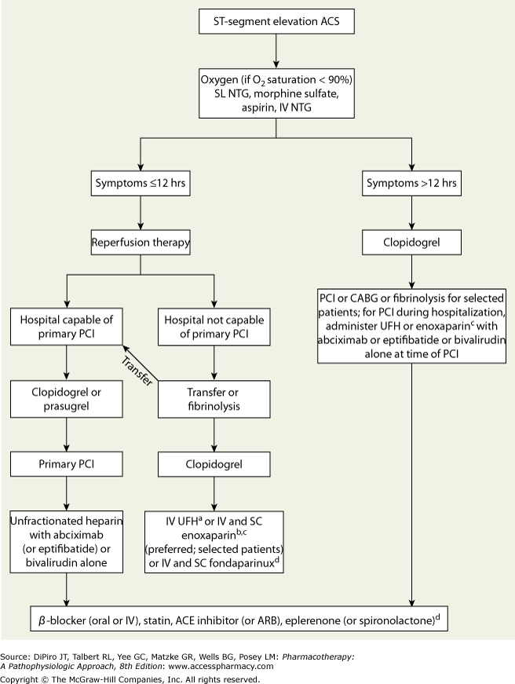

Slide 12
Initial Therapy: MONA
Morphine
Oxygen
Nitroglycerin SL
Aspirin:
Metoprolol
UFH
Order | Drug | Dose | Note
1st | ASA | 162 mg chewed | Do not use enteric coat (want fast onset)
2nd | Nitroglycerin SL | 0.4 mg SL q5min 3x doses | Use IV if no relief
3rd | Morphine | 2 mg IV q10 min prn chest pain | Use if continued chest pain
4th | Metoprolol Tartrate | 5 mg slow IV push (over 1-2 min) q5min x 3 then 25 – 50 mg PO q6hrs | Make sure pt has no signs of HF b/c it’ll make them feel worse
5th | UFH | 5000 Units SQ q8-12h | Get ready for reperfusion
Notes:
Aspirin inhibits thromboxane A2
Acute: 5 mg slow IV push (over 1-2 min) q 5 min x 3, then 25 – 50 mg po q6hrs

Slide 13
Primary Percutaneous Coronary intervention PCI (preferred) aka Balloon time
Within 90 min of hospital presentation
Why PCI is preferred over fibrinolytic
1. lower mortality rate
2. decrease risk of stroke
3. decrease risk of bleeding

Slide 14
Fibrinolytic Therapy (Alteplase)
Within 30 min of hospital presentation
Goal: reopen coronary artery
Can give fibrinolytic if all 4 is met...
STEMI (do not give if NSTEMI)
Symptoms within 12 hours
2 back to back ST elevations
Door to Needle Time: patient must be given fibrinolytic within 30 min of presentation
Absolute Contraindications
Previous intracranial hemorrhage
Ischemia stroke within 3 months
Known intracranial neoplasm or structural lesion
Close head or facial trauma within 3 months
Active internal bleeding
Suspected aortic dissection
Relative Contraindications
Uncontrolled HTN > 180/110
Hx of stroke > 3 months
Internal bleeding within 1 month
CPR within 3 weeks
pregnant
Side Effects
#1. Intracranial hemorrhage (ICH)

Slide 15
Fibrinolytic Therapy (Alteplase)
Within 30 min of hospital presentation
Drug | Fibrin Specificity | Dosage
Streptokinase | + | 1.5 million units in 50 mL infused over 60 min
Reteplase (rPA) Retavase | ++ | 10 units IV push over 2 min 30 min later… another 10 units IV push
Alteplase (tPA) Activase | +++ | Step 1: 15 mg bolus followed by Step 2: 0.75 mg/kg (max 50 mg) infusion over 30 min Step 3: followed by 0.5 mg/kg (max 35 mg) over 1 hr
Tenecteplase (TNK-tPA) TNKase | ++++ | < 60 kg = 30 mg IV bolus 60–69.9 kg = 35 mg IV bolus 70-79.9 kg = 40mg IV bolus
Monitor:
S/S of bleeding
mental status – blood might be in dome piece
Hg/Hct – might be high on 1st day b/c patient is dehydrated
Notes:
Know heparin dosing
Know heparin max dose
Know enoxaparin is renally cleared
Know Fondaparinux is contraindicated if CrCl is renally cleared and is ok for pts with HIT
If MI w/o fibrinolytic → 80/18
If MI with fibrinolytic → 60/12

Slide 16
Ancillary Therapy
LMWH: Enoxaparin
or
fondaparinux if tx > 48 hrs
or
UFH (x 48 hrs)
Fibrinolytic + Anticoagulants + Antiplatelet
Drugs | Dose of anticoagulants | If CrCl < 30 ml/min | Extra notes
Enoxaparin (Lovenox®) *preferred | 30 mg IV bolus followed immediately by 1 mg/kg subQ q12h | Renally cleared 1 mg/kg subQ q24h | If age > 75 years: eliminate bolus and dose 0.75 mg/kg subQ q12h
UFH | 60 units/kg IV bolus (max 4000 Units) followed by 12 units/kg/hr (max 1000 Units/hr) | No need for renal clearance | Chance of HIT Adjusted to maintain aPTT 1.5 - 2 X control
Fondaparinux (Arixtra®) | 2.5 mg IV, followed by 2.5 mg subQ daily No chance for HIT | Contraindicated if CrCl < 30 ml/min | No chance for HIT Goal: aPTT 1.5 – 2x control
Notes:
UFH dosing:
If MI w/o fibrinolytic → 80/18
If MI with fibrinolytic → 60/12

Slide 17
Notes:
After fibrinolytic, clopidogrel 75 mg (at least 14 days) + ASA
PCI: plavix d/c 5 days prior to surgery

